Slide 1
Smart Plant Monitoring System Ashish Kumar 2019UCO1518 Sandeep Jain 2019UCO1522 Nishant Goel 2019UCO1529

Slide 2
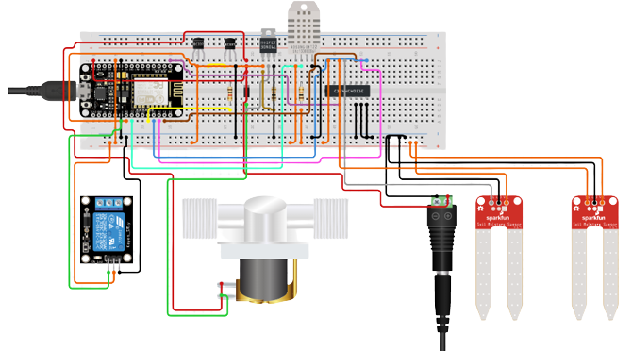
PROTOTYPE
ESP8266 WiFi Module
Soil Moisture Sensor
Relay Module Single Channel
DHT-22 sensor
Solenoid Water Valve
Bread Board
Jumpers

Slide 3
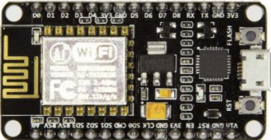
Node-MCU ESP8266
Node-MCU is an open source firmware for which open source prototyping board designs are available. The prototyping hardware typically used is a circuit board functioning as a dual in-line package (DIP) which integrates a USB controller with a smaller surface-mounted board containing the MCU and antenna.

Slide 4
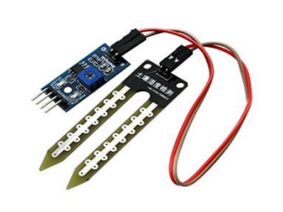
Soil Moisture Sensor
Soil moisture sensors measure the volumetric water content in soil. Since the direct gravimeter measurement of free soil moisture requires removing, drying, and weighing of a sample, soil moisture sensors measure the volumetric water content indirectly by using some other property of the soil, such as electrical resistance, dielectric constant, or interaction with neutrons, as a proxy for the moisture content.

Slide 5
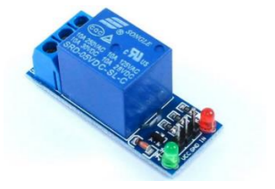
Relay Module
Relay is an electromechanical device that uses an electric current to open or close the contacts of a switch. The single-channel relay module is much more than just a plain relay, it comprises of components that make switching and connection easier and act as indicators to show if the module is powered and if the relay is active or not.

Slide 6
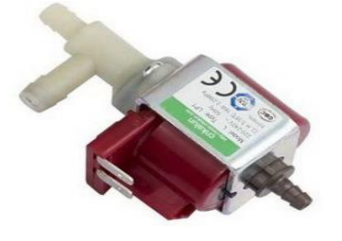
Solenoid Water valve
A solenoid dosing pump is a form of positive displacement pump which uses a diaphragm and solenoid assembly to displace the fluid into the discharge line. The solenoid 'drive' consists of an electromagnet and spring assembly, which is activated/deactivated with a series of electrical impulses

Slide 7
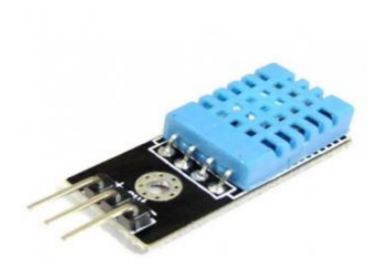
DHT22 Temperature sensor
The DHT22 is a basic, ultra low-cost digital temperature and humidity sensor. It uses a capacitive humidity sensor and a thermistor to measure the surrounding air, and spits out a digital signal on the data pin (no analog input pins needed). Its fairly simple to use, but requires careful timing to grab data.

Slide 8
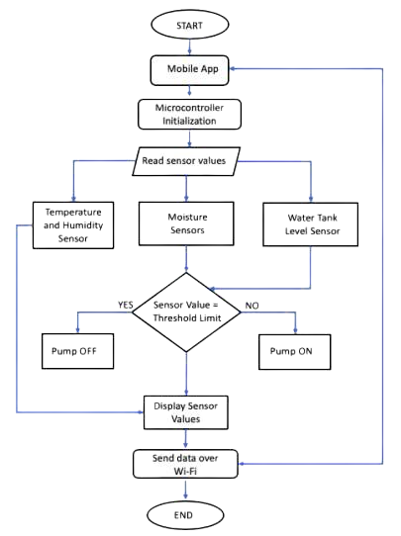
Working of the module

Slide 9
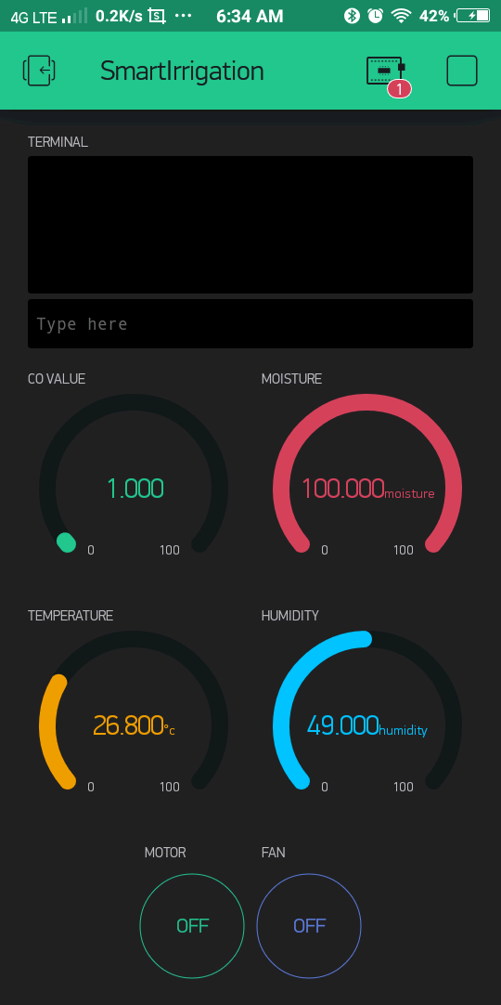
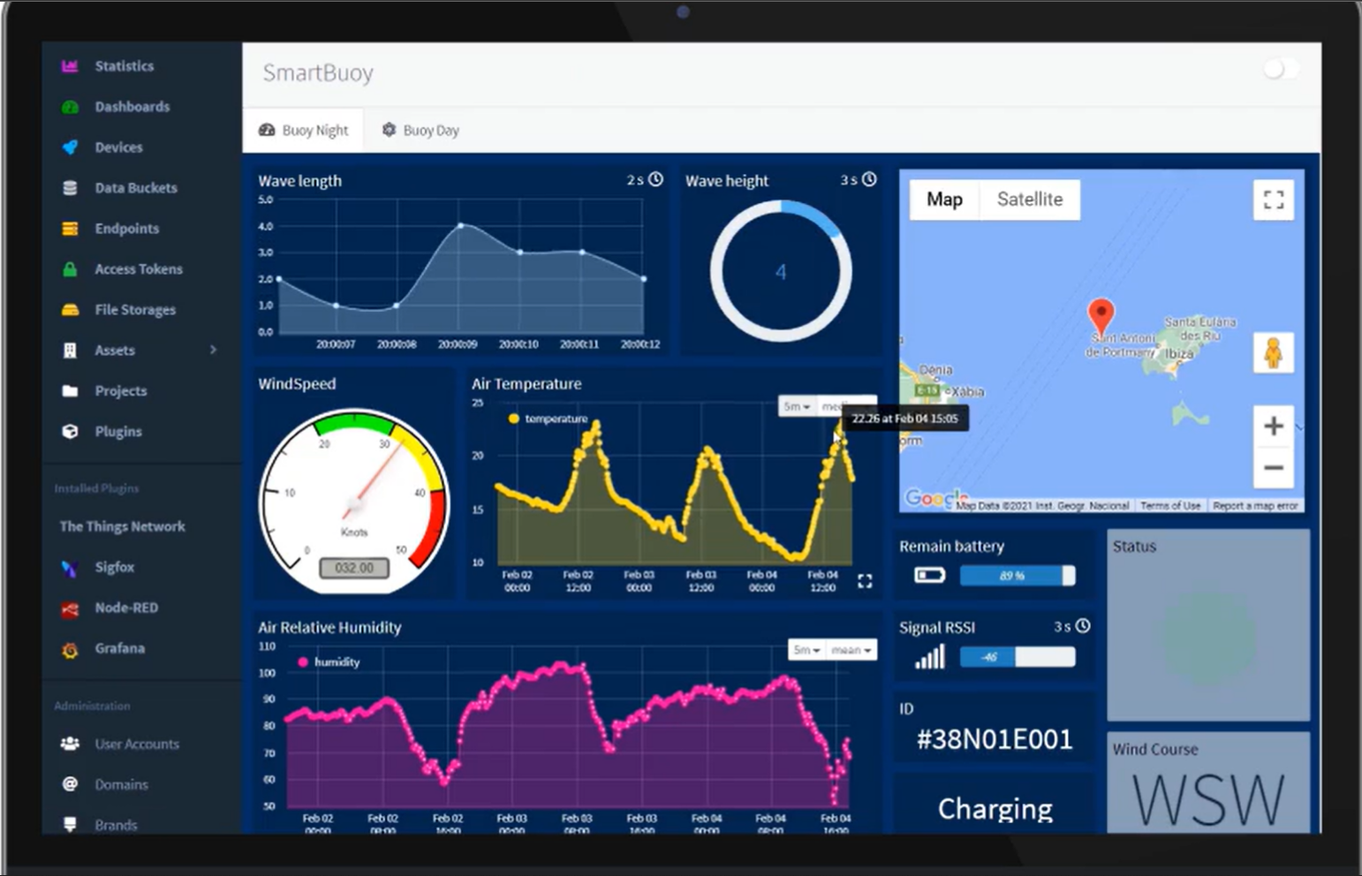
BLYNK
THINGER.IO

Slide 10
Project Timeline
Component Assemble
Network Layer
Build a working prototype of the model, modify and improve in further stages
Data Transmission and Acquisition using network gateways and topologies
proposal
Architecture
hardware
software
marketing
Sensing Layer
Intelligent Insights and Actions
Smart Plant Monitoring System
Data Gathering using physical objects, sensors and actuators
Deployment and real time usage

Slide 11
THANK YOU

